Slide 1
2025 New York State
Missing Children’s Day Poster Contest Winners

Slide 2
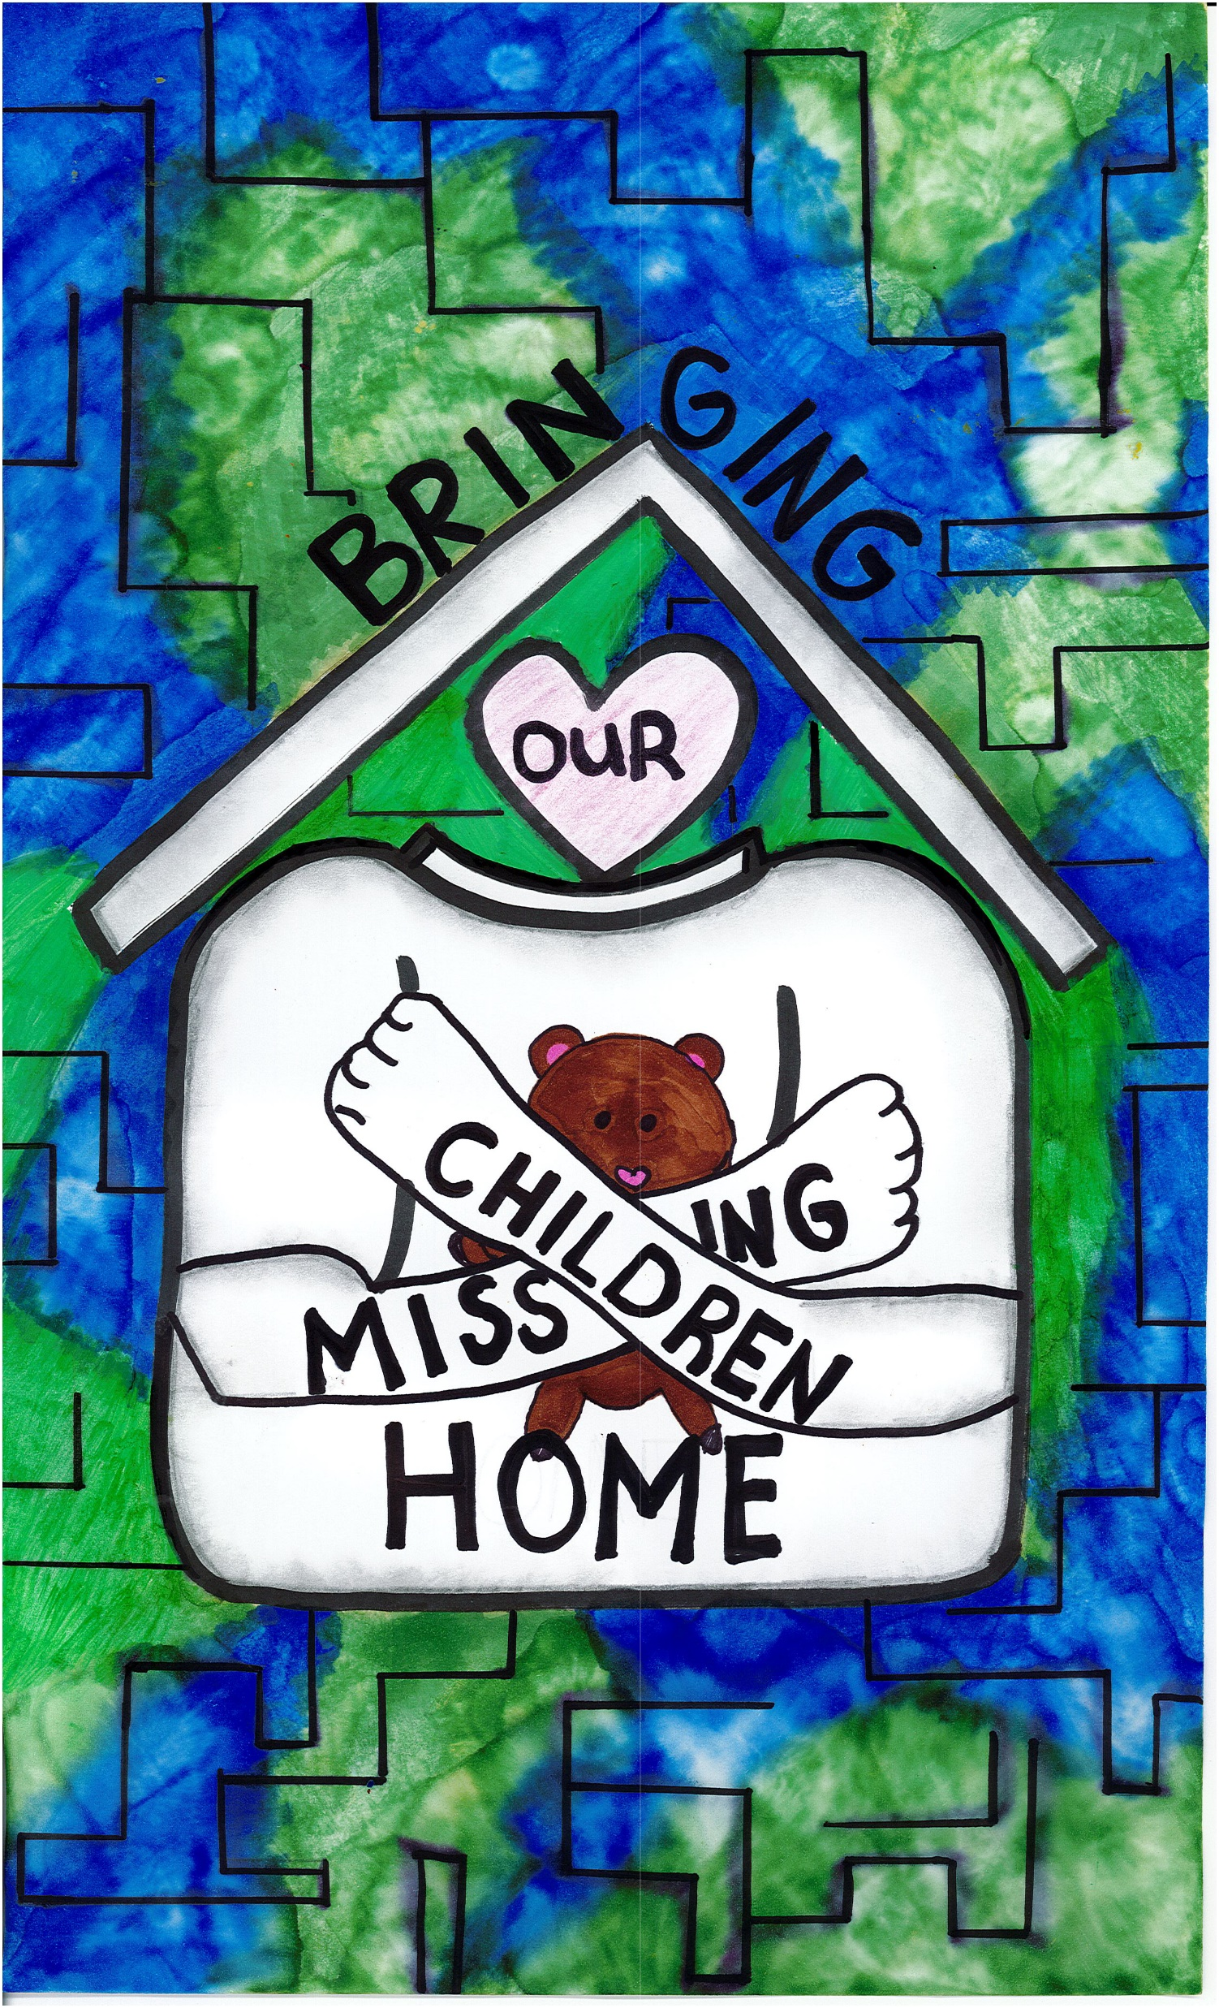
New York
First Place:
Hailey Morey
Cicero, NY
My poster shows strong arms hugging a teddy bear and waiting for a missing child to return home. I drew a “map” in the background of my poster to show we are all connected and our goal is to help children. This is a symbol to never lose hope. My design was created from thinking about the stories my mom, a special education teacher, tells me. Her students have a hard time expressing themselves with words. I used the American Sign Language symbol for the word hug.

Slide 3
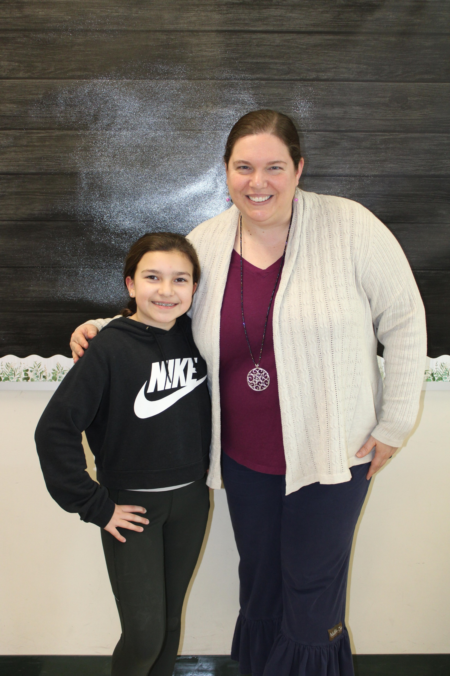
Hailey Morey with her teacher
Ms. Gwynn

Slide 4
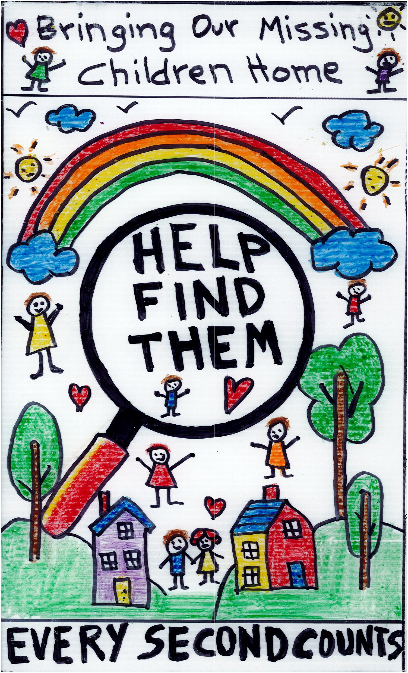
My poster is about raising awareness to find missing kids and bring them back to their families. I used bright colors, bold words, and meaningful pictures so people would notice and think about how they can help. I believe that working together as a community is the best way to keep children safe. This poster shows that every second counts when a child goes missing and I hope it makes people realize how important it is to pay attention and report anything that might help. I want my poster to remind everyone to never give up on finding missing kids.
New York
Second Place:
Gerard Bonilla
Mount Vernon, NY

Slide 5

Gerard Bonilla with his teacher
Ms. Ferraro

Slide 6
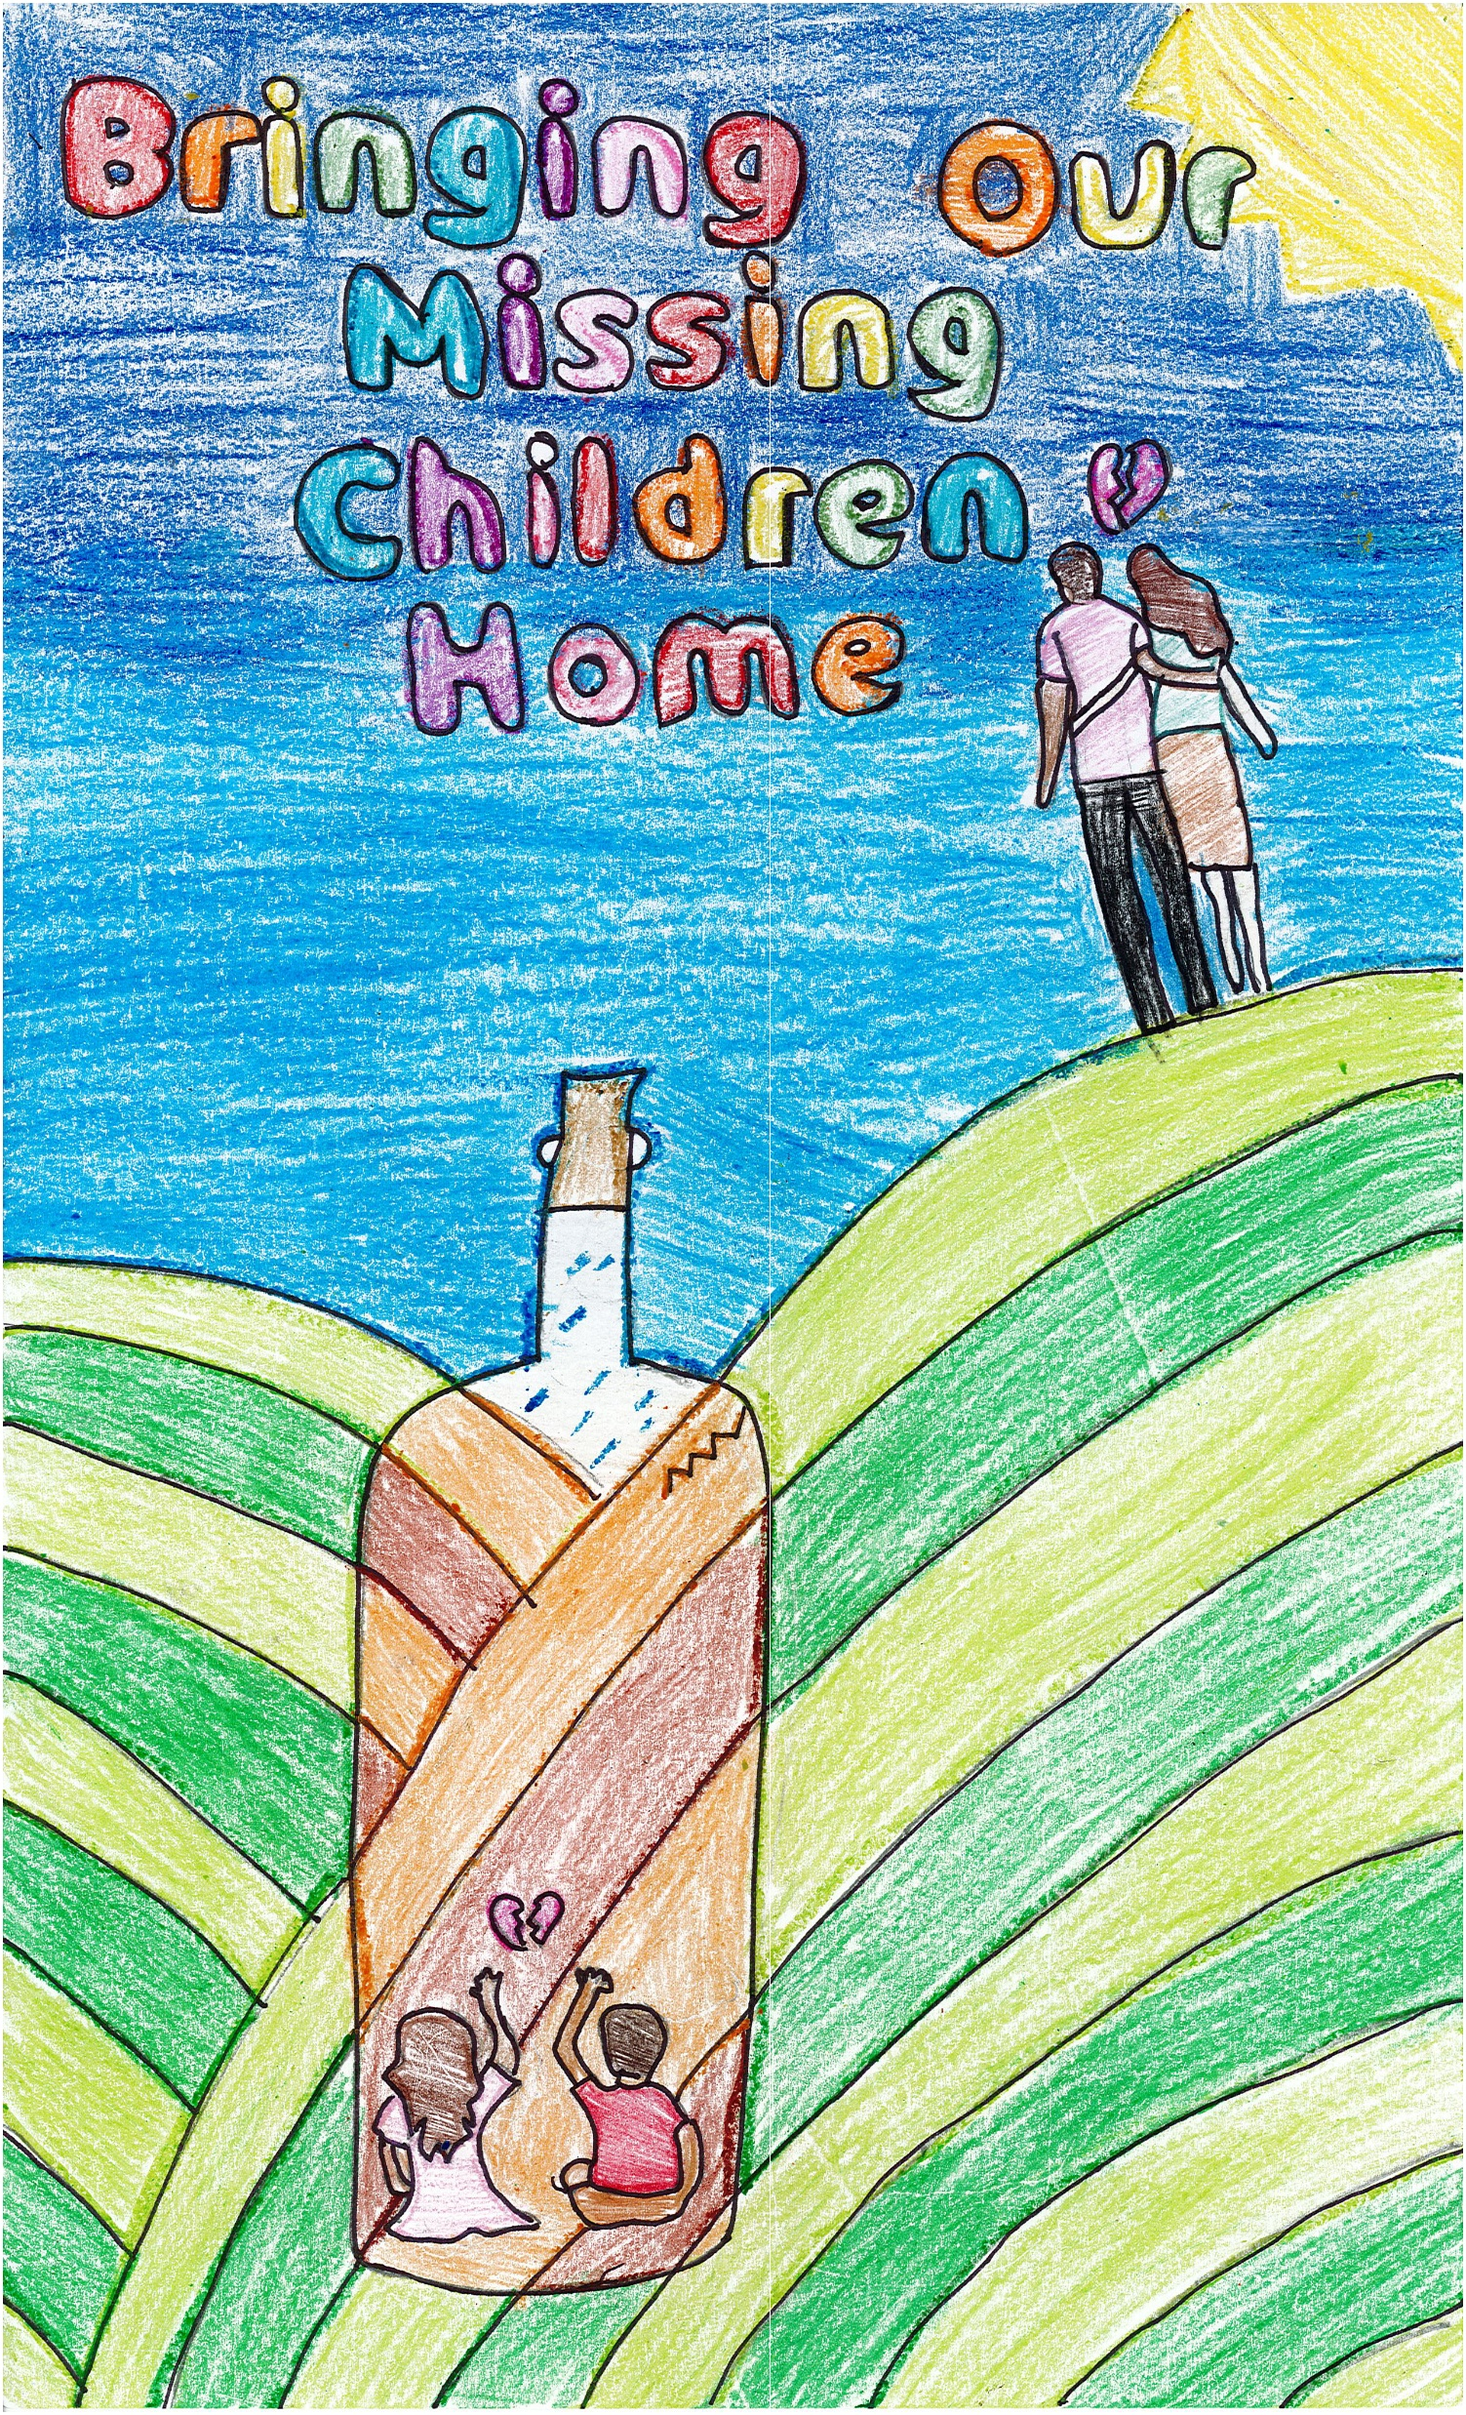
My inspiration to make this art piece is the fact that a lot of kids are trapped somewhere around the world and the bottles symbolizes being trapped, because if you were to be in a bottle you could not get out without someone else’s help. The crack in the bottle symbolizes being in an unsafe place. If you can see the outside of the bottle it is sunny, the grass is green, and the sky is blue but inside the bottle it is raining the grass is brown and the sky is grey so that symbolizes that when you are trapped you are not happy and everything is sad and depressing. The hill is supposed to represent that the kids are far away from their parents.
New York
Third Place:
Sofia Alexandra Acebo
Calverton, NY

Slide 7
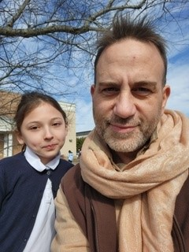
Sofia Alexandra Acebo with her teacher Mr. Barbera

